Slide 1
Wisconsin Security Inspections
Megan Shober
Nuclear Engineer
August 23, 2016
Division of Public Health, Bureau of Environmental and Occupational Health
Notes:
Wisconsin has a couple dozen licensees under Part 37. Our Part 37 requirements went into effect on February 1, 2016 and we initiated Part 37 inspections on March 1.

Slide 2
Overview
Inspection results
Common problems
Rule interpretation issues
Notes:
We hosted a Part 37 workshop for our licensees in March 2014 and posted the presentation on our website. We spoke about the transition on all IC inspections. Last fall we sent out versions of Ohio’s checklists and then followed that up with phone calls to all the RSOs. Based on these numerous outreach efforts, we decided not to grant leniency to licensees with Part 37 implementation. We began issuing security violations as of the implementation date.

Slide 3
Inspection Results
Increased Controls Orders (ICs)
  In place from May 2006-January 2016
  No violations given on initial inspections
  Initial inspections repeated until compliance achieved
10 CFR 37
  Became effective on February 1, 2016
  Licensees were expected to be in compliance as of the effective date
  Have inspected half of our licensees so far

Slide 4
Inspection Results
Subpart B
  Background investigation and access authorization programs
Subpart C
  Physical protection requirements during use
Severity Level
  1 through 4
  1 is most severe

Slide 5
Inspection Results
Violations by Subpart
Notes:
So let me describe what you are seeing here. On the left is a graph showing all of the violations we issued under Increased Controls for the eight years they were in place. We issued 25 violations about the T&R process and 3 about actual physical protection. On the right is a graph showing the violations we have issued to date under Part 37, which went into effect in Wisconsin on February 1.
You will notice the drastic difference in the type and number of violations cited. One reason for that is when the ICs first went into effect, we recognized that it was a major change for licensees. We wanted to give them the benefit of the doubt during implementation, and frankly we were also reluctant to cite security violations. So, for better or worse, our original inspection policy was not to cite violations but to re-inspect until the problems were fixed and then issue a clear inspection report. For reasons I will go into later this worked at the time but made things difficult later on and was not a philosophy we considered for the Part 37 implementation. Another reason is that when the ICs were first implemented, many licensees were able to approve most of their T&R employees by only reviewing the previous three years of employment. This is a relatively difficult task to mess up, and we had few problems with T&R compliance initially. As time passed and licensees hired new employees and the Fingerprinting Orders went into effect, we saw a rise in T&R violations.
Since inspecting under 10 CFR 37, we have seen a significant rise in the number of physical protection violations. This is because, in general, most of 10 CFR 37 Subpart B was required under the ICs. And most of the elements that are new in Part 37 are in Subpart C. This is where we’ve seen licensees falling short.

Slide 6
IC Inspection Results
Violations Per Year
Notes:
With blood irradiators on five-year frequencies, we did many fewer IC inspections in 2011-2013

Slide 7
10 CFR 37 Inspection Results
Violations Per Inspection

Slide 8
Inspection Results
Violations by Severity Level (SL)
8
Notes:
Here is a similar graph breaking the inspection results out by severity level. In general, we issue Severity Level 4 violations for isolated incidents and Severity Level 3 violations for programmatic breakdowns (or repeat violations).
Under Part 37, we have issued many more Severity Level 3 violations. Most of this is due to “failure to implement”, licensees that did not even try to develop access authorization procedures, or security plan or implementing procedures, or (Aaron’s favorite) a means to detect attempted unauthorized removal of a radioactive material from a security zone. If licensees “tried and failed”, the violation was cited as Severity Level 4.

Slide 9
IC Inspection Results
Violations Per Year

Slide 10
10 CFR 37 Inspection Results Violations Per Inspection

Slide 11
Common Problems
10 CFR 37.43(a): security plan
10 CFR 37.47: security zones
10 CFR 37.43(b): implementing procedures
10 CFR 37.23(e)(5): not updating list within 7 days
10 CFR 37.49(a)(3): can’t detect removal
10 CFR 37.23: no access authorization procedures
Notes:
These listed problems have been cited at three or more licensees. Problems are in order of frequency.
Security plan-8 violations (1 SL3/7 SL4)
Security zone-7 violations. (6 SL3/1 SL4)
Implementing procedures-5 violations. (2 SL3/3 SL4)
Not updating list-4 violations. (1 SL3/3 SL4)
Can’t detect removal-4 violations (4 SL3)
No access procedures-3 violations (3 SL3)

Slide 12
Rule Interpretation Issues
Background investigations
Education verification
Detecting unauthorized removal

Slide 13
Background Investigations
10 CFR 37.25(a)
“The scope of the investigation must encompass at least the 7 years preceding the date of the background investigation…”
  How long are investigation elements “good for” before a licensee has to solicit updated information?
  Can a licensee use employment reference checks for the character determination?
  When licensees contract background checks to third-party companies, how do they ensure the check meets Part 37?
  How hard should we push for licensees to collect independent information?
Notes:
1: For example, if checks were made at the time of hire, and a year lapses before the individual seeks approval for unescorted access, is there any information that has to be re-verified?
2: Must be limited to whether someone has been and continues to be trustworthy and reliable. How do I inspect that?
3: When licensees contract background checks, do they get access to the primary data? We have seen multiple cases where a contractor is not checking back far enough (3 yrs vs. 7 yrs) or is only verifying the most recent degree. Licensees also are relying on information provided by the applicant as part of the hire, which is limited to information relating directly to the job posting.
4: How am I supposed to inspect against “to the extent possible”?

Slide 14
Education - 10 CFR 37.25(a)(4)
Does a licensee have to verify education if it happened more than 7 years ago?
  The investigation must encompass “at least” the 7 years preceding.
  Licensees must verify that the individual participated in the education process “during the claimed period.”
  NUREG-2155, p. 71 A2: “A licensee does not need to verify an individual’s education if such verification occurred more than 7 years ago.”
Notes:
The timeframe for employment checks is very clear: the past seven years. For education, the regulations are more vague. We are telling licensees not to request information more than seven years old.

Slide 15
Education - 10 CFR 37.25(a)(4)
What is “the education process”?
  Is it only from an accredited institution?
  Is it only when an individual is working toward a degree?
  What about “continuing education”?
High school
Notes:
What about the photography class I took at the local technical college a few summers ago?
Are licensees expected to verifying continuing education for physicians and physicists?
We have had numerous issues, particularly with radiographers and blood banks, failing to verifying a high school degree obtained when an applicant was 18.

Slide 16
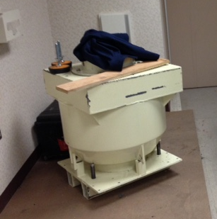
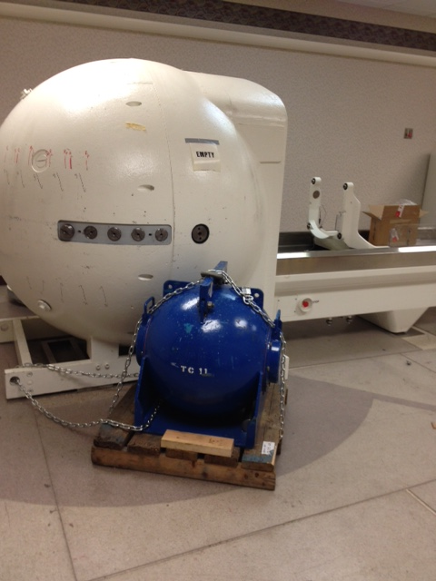
Detecting Removal –
10 CFR 37.49(a)(3)
Difficult to apply to Category 1 quantities that have become mobile.
Notes:
Here are two pictures I took near the end of a gamma knife source removal, and I want to highlight two issues. First, 37.49(a)(3) requires Category 1 licensees to have a means to immediately detect unauthorized removal of radioactive material. This is normally accomplished by an electronic detection tied to an alarm system but may also be accomplished by constant surveillance. A gamma knife source removal takes several days, which is a long time for 24 hour constant surveillance. In addition, the sources are collected in a hot cell that belongs to the service provider, so I am not sure how a licensee could install a security feature on the service provider’s equipment. Fortunately for us and for our licensee, the work depicted in these photos occurred the week before Part 37 went into effect.
Second, we got to wondering if this would be considered a mobile device. The definition of “mobile device” says a device on wheels or casters, or designed to be hand-carried. In this case, more specialized equipment was required to move the device, but the equipment was located in the same room. We ended up requiring the licensee to chain the hot cell to the gamma knife frame at night to provide a second barrier (in addition to the door to the treatment room).

Slide 17
Questions?
Megan.Shober@wisconsin.gov
(608) 287-4422
Division of Public Health, Bureau of Environmental and Occupational Health

