Slide 1
Leaking PET Calibration Source
Megan Shober
Nuclear Engineer
August 25, 2016
Wisconsin Department of Health Services
Bureau of Environmental and Occupational Health
Notes:
Thank California and Tennessee for their contributions to this investigation.

Slide 2
Overview
Incident
Root cause
Lessons learned
Notes:
The licensee was a stand-alone oncology clinic that performs PET studies. At the time of the incident, the licensee had held their RAM license for less than two months. They had a brand new PET camera. The licensee’s nuclear medicine technologist had been routinely inspected under other RAM licenses, and the licensee had a consultant RSO who was also very well known to us.
This was the first PET camera produced by this manufacturer in over a decade, and our licensee was only the second licensee in the country to install this camera. As such, the device manufacturer had been spending a lot of time onsite commissioning the device using both local and national service engineers.

Slide 3
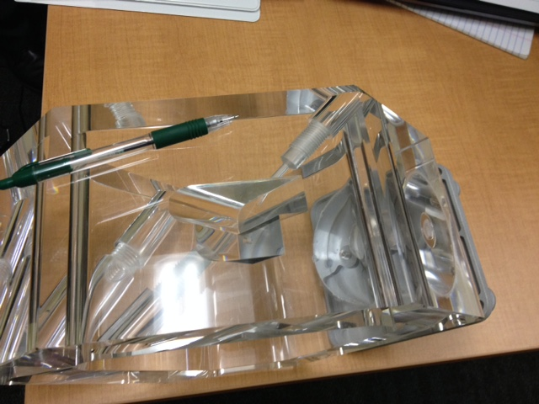
The Source
5 millicurie germanium-68 PET “line” source
Only used in one model of PET camera
Licensee used source in a needle cap
Service provider used source in a holder which was placed in a phantom
Notes:
The source was very small. The manufacturer claims it is 0.2 mm.
The source had decayed to 4.4 mCi at the time of the incident report.
Licensee used source every two weeks for camera QA.
Service provider used during camera installation and monthly thereafter.

Slide 4
The Incident
The licensee detected contamination on the underside of their PET table
Identified sealed source was leaking
Performed area and personnel surveys
Contaminated items shipped to manufacturer for disposal
Notes:
Contamination identified on a Friday during routine surveys. Over the weekend, the nuclear medicine technologist performed additional surveys of restricted and unrestricted areas at the facility. No additional contamination was identified. On Monday, the licensee identified that the source was leaking. On Monday the licensee also asked the service engineers to return to the site, discovered other contaminated items.
Licensee notified us on November 5, 2015 of the leaking source. We performed a reactive inspection on November 11, 2015.
Per the manufacturer’s calculations, items besides the source totaled 0.428 uCi of contamination.
Talk about screwdriver.

Slide 5
Contamination
2.28 microcuries on wipe test of source
0.428 microcures of other contamination
  Source holder, gloves, other wipes
  Screwdriver (100,000 counts per minute)
  Interior of tool bag (28,000 counts per minute)
No contamination in vehicle or homes
Notes:
Confirmed that screwdriver and tool bag were only used at this jobsite during the time period in question.

Slide 6
Manufacturer’s Investigation
Unable to determine what caused weld to open
Source may have exceeded specification dimensions

Slide 7
Root Cause
Service engineers had inadequate training for handling radioactive material
Licensee provided inadequate oversight of service engineers
Notes:
Fortunately for us, the licensee agreed that the service engineers had been working under the authority of the clinic’s license.
We cited our licensee for failure to provide adequate supervision.

Slide 8
Corrective Actions
Licensee
  Additional training to service engineers
  More frequent surveys
Service provider
  Additional training to engineers
Manufacturer
  Doubled thickness of source wall

Slide 9
Lessons Learned
Not always clear when service providers are working under the authority of the client’s license
  Tasks not performed by the licensee
  Work often performed in off-hours
  Assume device manufacturers know what they are doing
High value to routine surveys
Notes:
“Our training program is approved by the State of California” – Device RSO
In this case, the device manufacturer could not have filed for reciprocity because they didn’t have a service provider license anywhere.
Cited licensee for failure to provide adequate supervision.

Slide 10
The Second Incident
Licensee received a new “double thickness” source in early December
Used once and confirmed no problems
Identified as leaking after second use
Notes:
NMT was already concerned about source leakage so she wiped the source the day after the service engineers performed work and identified the contamination.
She called the engineers to come in and

Slide 11
Contamination
7.57 microcuries on wipe test from source
Limited contamination at licensee’s facility
No contamination found in vehicles or homes
Contamination identified on service engineer’s finger (0.8 mR/hr)
  Cleaned to background within 5 days
  Licensee’s assessment showed 200 mrem dose
Notes:
Contamination was found on a needle cap, the sleeve of the well chamber, and the source holder which is put in the phantom.

Slide 12
Root Cause
Second source not compromised by service engineer’s actions
Licensee unable to determine a cause
Manufacturer believes leakage due to source chemistry

Slide 13
Manufacturer’s Analysis
Germanium-68 received from supplier had previously been in a non-acidic solution
In 2015, supplier began providing germanium-68 with acidic residue
  For long line sources or plane sources, the volume of the source reduced the effects of the acidity
  Acidic residue reacted with stainless steel, producing gas, which escaped through weakest point (the weld)

Slide 14
Corrective Actions
Licensee
  Acquired source from different manufacturer
  Permanently mounted source in acrylic source holder
Service provider
  Issued survey instruments to engineers
Manufacturer
  Neutralize acid before making sealed source

Slide 15
Lessons Learned
Keep an open mind
Basic radiation safety precautions have significant effect on limiting negative consequences
Consider safety during engineering stage

Slide 16
Questions?
Megan.Shober@wisconsin.gov
(920) 448-5346

